Slide 1






Soft Solutions
UEIT: Unreal Engine 5.5 Inventory Tool
www.softsolutions.com
Riga Tehnical University - Applied System Software
Spring 2025

Slide 2



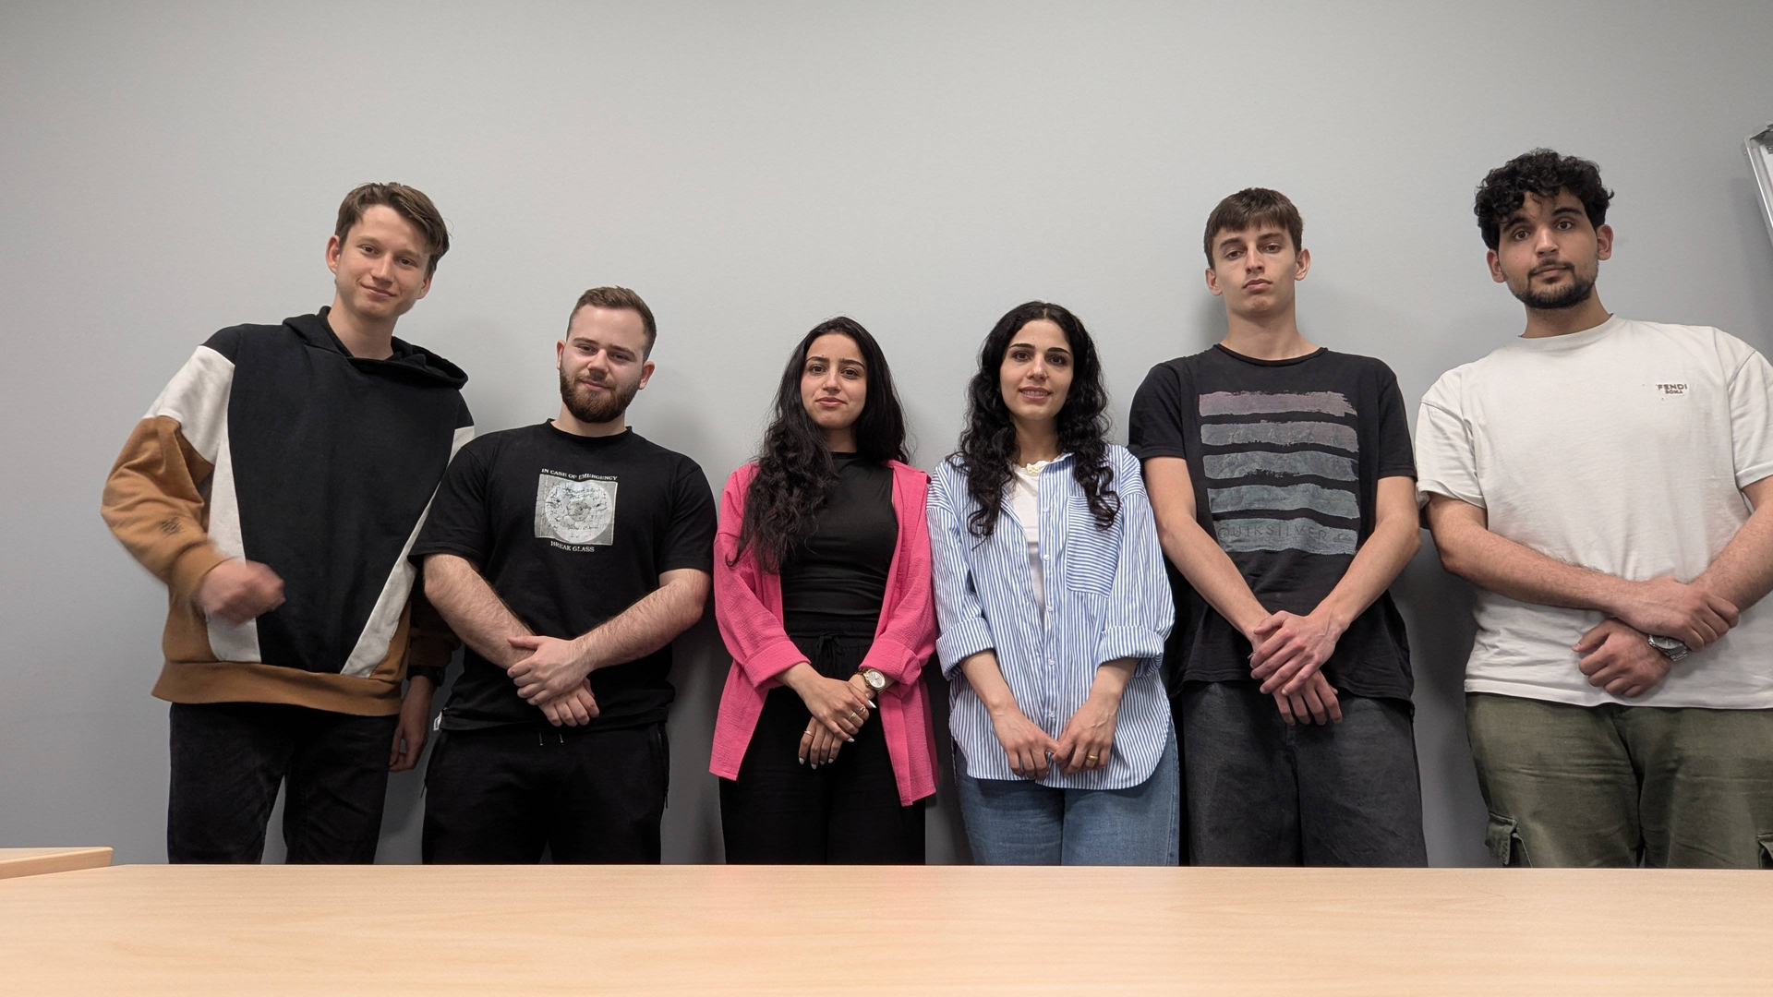


Our Team
We are a team of software engineering students passionate about building innovative solutions. With diverse skills in coding and problem-solving, we collaborate to develop high-quality applications. Driven by curiosity and teamwork, we embrace challenges and new technologies to create impactful software.
Soft
Solutions

Slide 3









Our Team Members
Yaseen Almahayshi
Georgi
Beev
Sorin Rammo
Developer
Developer
Tester
Lorin Rammo
Andrii Nazarkevych
Héctor
Hernández
Project Maneger
Designer
Designer
Soft
Solutions

Slide 4
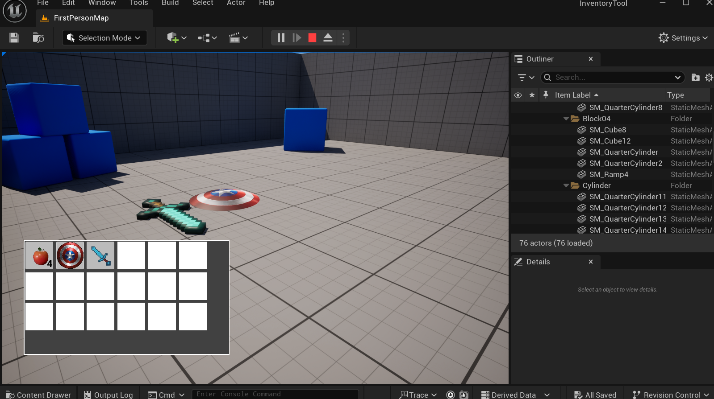

Soft Solutions
Our project
Our project focuses on developing a simple but functional inventory tool within Unreal
Engine 5.5, designed for use in video games or architectural visualization. The tool allows users to pick up, store, and discard 3D assets in a first-person playable environment.
Soft
Solutions

Slide 5
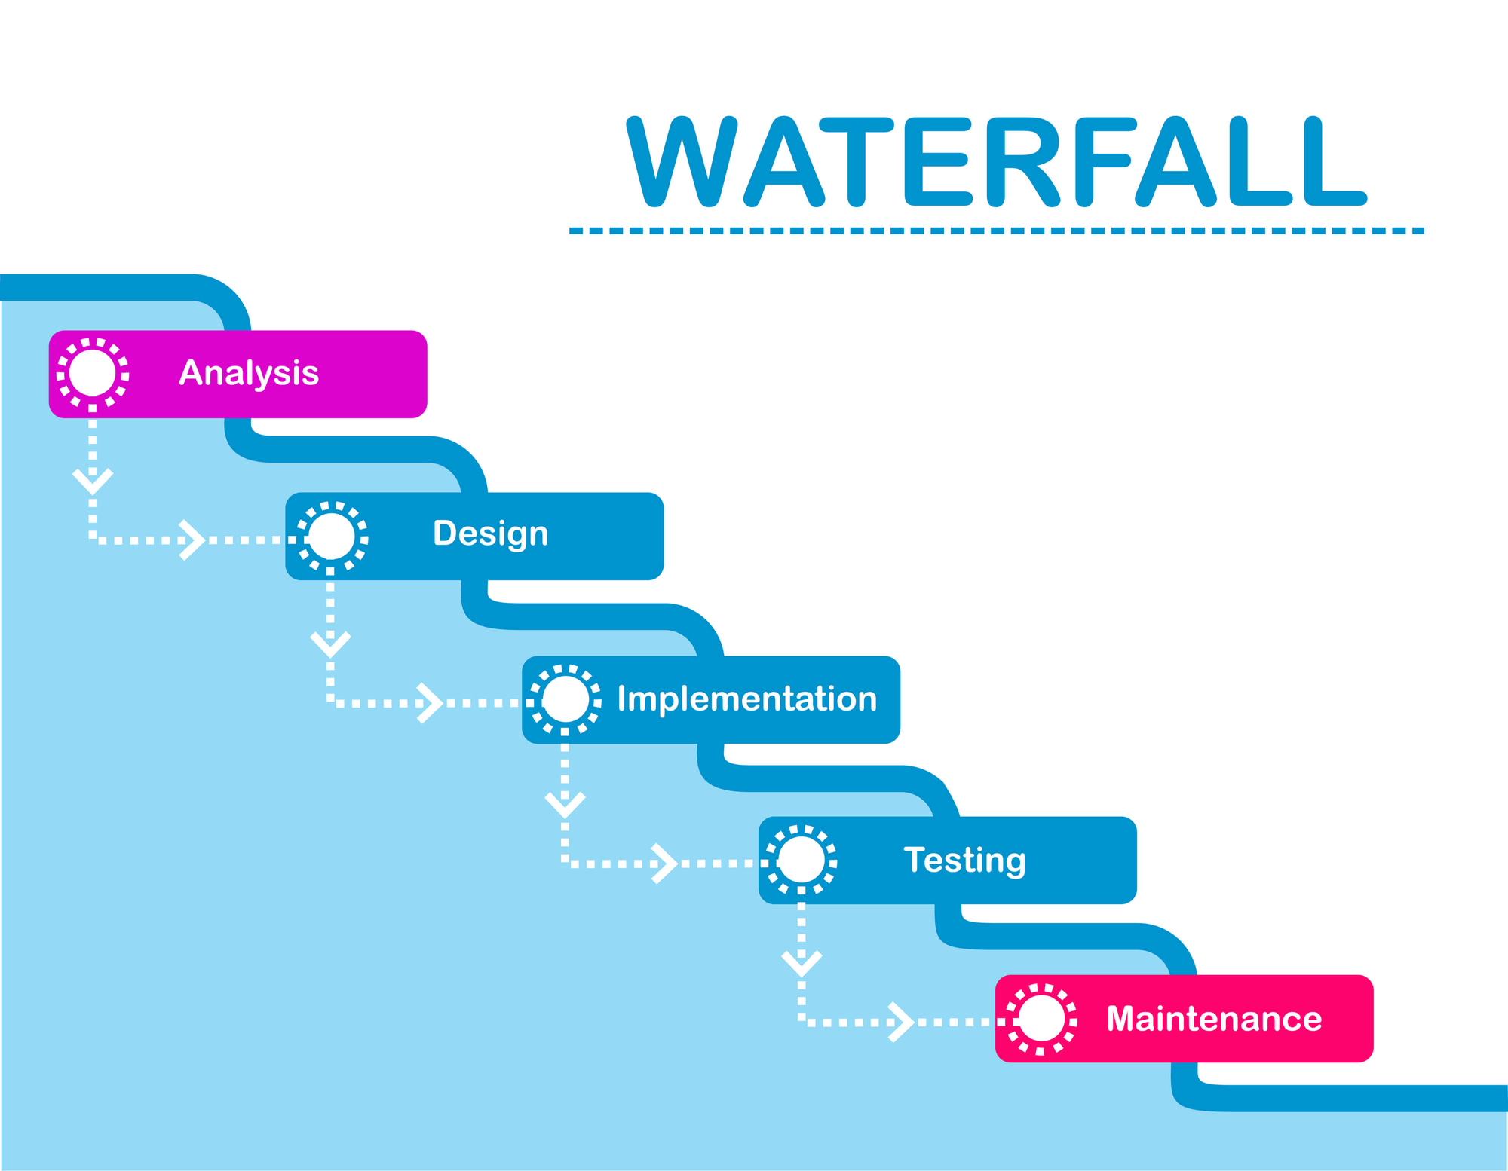
Soft Solutions
Chosen SDLC Methodology
Soft
Solutions

Slide 6

Requirements Gathering & Analysis
Initial client brief
Key Assumptions:
18-item limit
Discarded items stay in world
No multiplayer or categorization
Stackable/non-stackable support
Build the inventory system using Unreal Blueprints (visual scripting) or C++ for optimized performance.
Deliver a fully interactive first-person level where users can manage 3D assets seamlessly.
Soft
Solutions
Known Actions: Pick up, store

Slide 7
Software Requirements Specification
Functional Requirements:
Inventory capacity of 18 items
Click-and-drop UI
Stackable/non-stackable support
Persistent save/load
Non-Functional Requirements:
Smooth performance
Scalable for future multiplayer
Simple UX with keyboard/mouse interaction
Soft
Solutions

Slide 8
System and Software Design
Design Chosen: Modular with 3 classes (Inventory, Item, Player)
Easier to maintain
Scalable for future features
Clean separation of concerns
Soft
Solutions

Slide 9
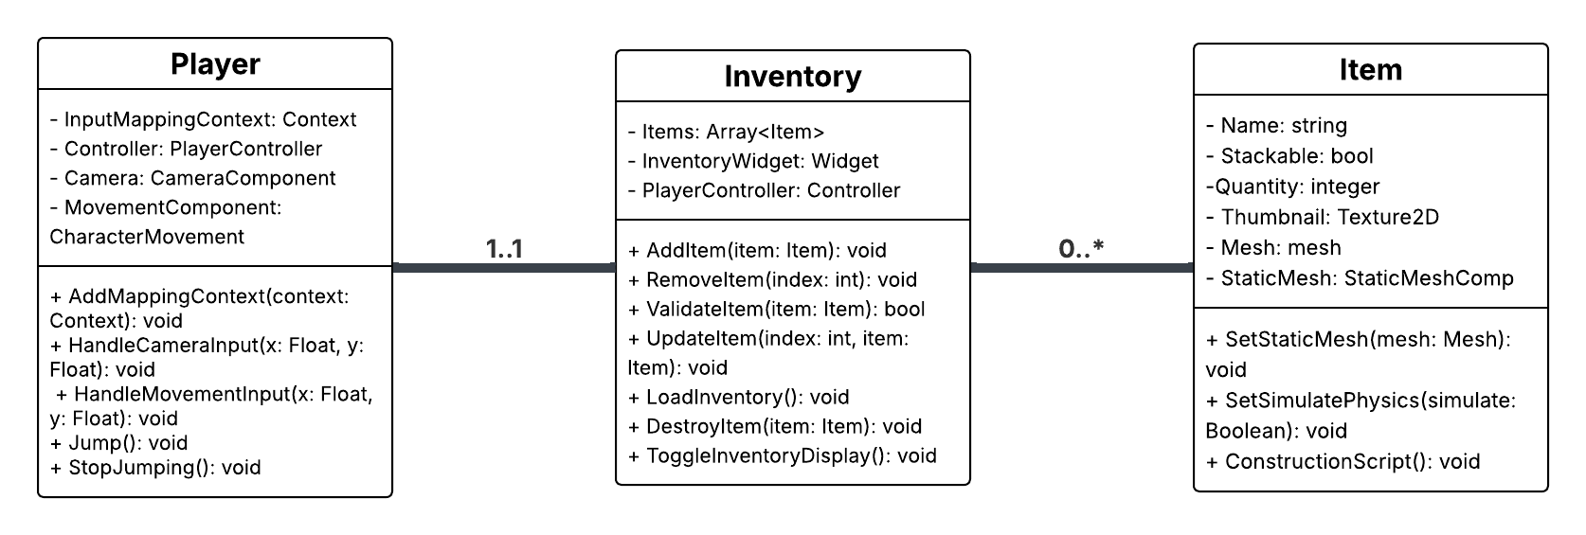
System and Software Design
Soft
Solutions

Slide 10
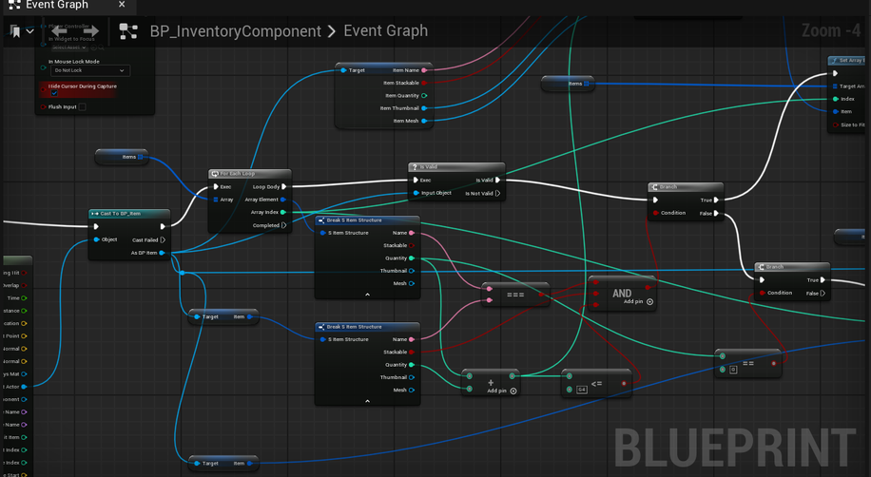
Implementation Phase
Implemented in Blueprints within Unreal Engine 5.5
Components:
Inventory_BP, Item_BP, Player_BP, UI_Manager_BP
Assets: Imported via Quixel Megascans (.FBX, .png/.exr)
Save/Load: Via UE5 SaveGame system
Key Bindings: E for pickup, I for inventory toggle
Soft
Solutions

Slide 11
Testing Strategy
Black-box testing: Based solely on requirements
Boundary value analysis: Inventory size (0–18 items)
Equivalence classes: Valid vs invalid input (file types, actions)
Manual playtesting (Blueprint = no unit testing)
Soft
Solutions

Slide 12
Test Results and Validation
Pick up valid item → ✅
Add item when full → ✅ Rejected
Load saved inventory → ✅ Items restored
Soft
Solutions

Slide 13
Process Challenges & Lessons Learned
Challenges:
Unreal Blueprint debugging was slower than scripted testing
UMG complexity in dynamic UI updates
Integrating drag-drop in inventory with persistent saves
Lessons:
Importance of clear modular design
Testing game logic via UX scenarios
Agile iterations improved feature quality
Soft
Solutions

Slide 14
Demo Overview
Demo Live
Soft
Solutions

Slide 15
Conclusion and Future Work
Achievements:
Working inventory tool in UE 5.5
Fully interactive and persistent
Future Work:
Add item preview/rotation
Extend to multiplayer
Add sorting/filtering for UI
Soft
Solutions

Slide 16
Q&A / Feedback
Soft
Solutions

